Slide 1
Gene Kim
IT Revolution, Author & Researcher

Slide 2
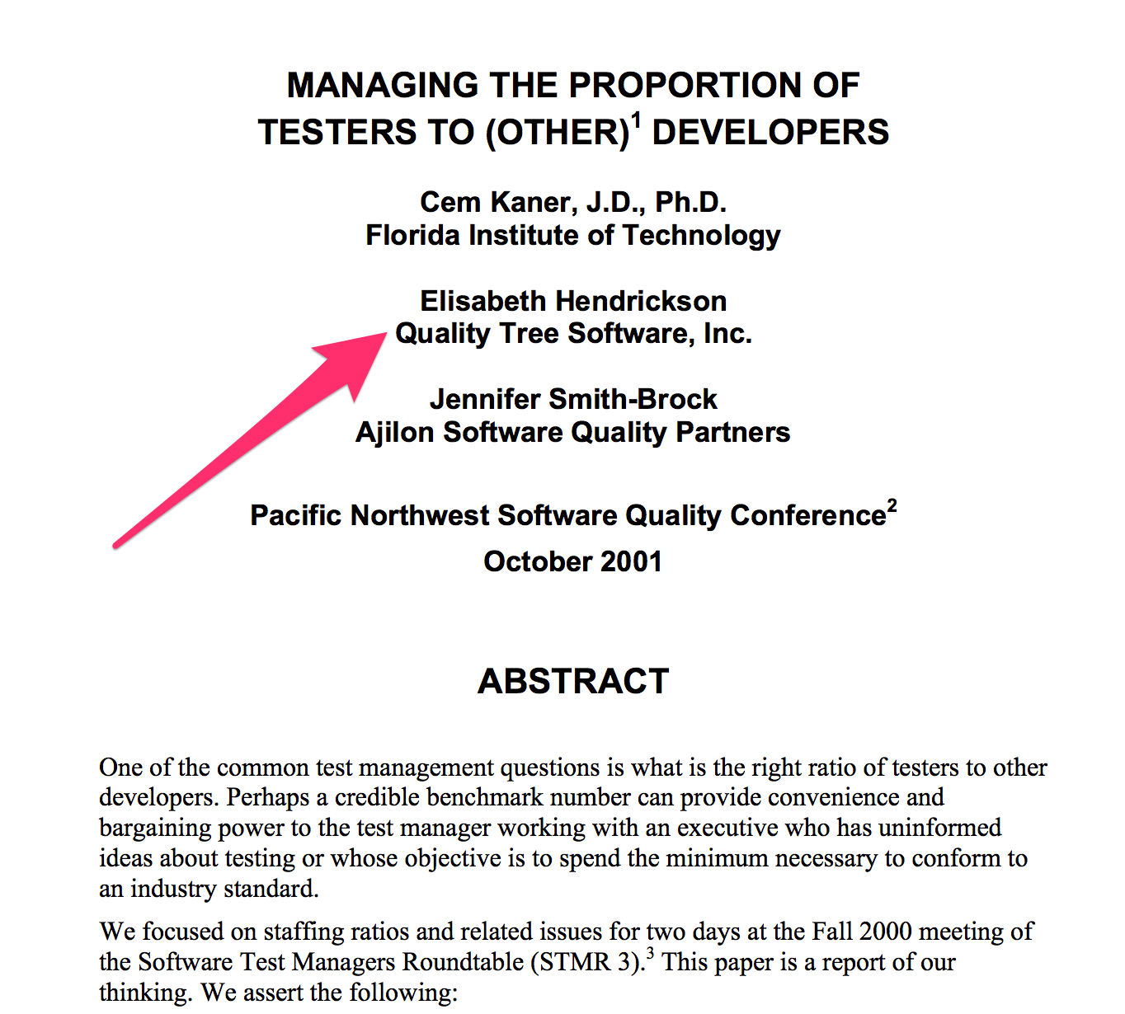

Slide 3
Elisabeth Hendrickson
Pivotal’s Big Data Suite,
VP of Engineering

Slide 4
On the Care and Feeding of Feedback Cycles
How improving feedback cycles accelerates software development…and also creates a learning organization
Elisabeth Hendrickson
@testobsessed
VP Engineering, Big Data Suite, Pivotal

Slide 5
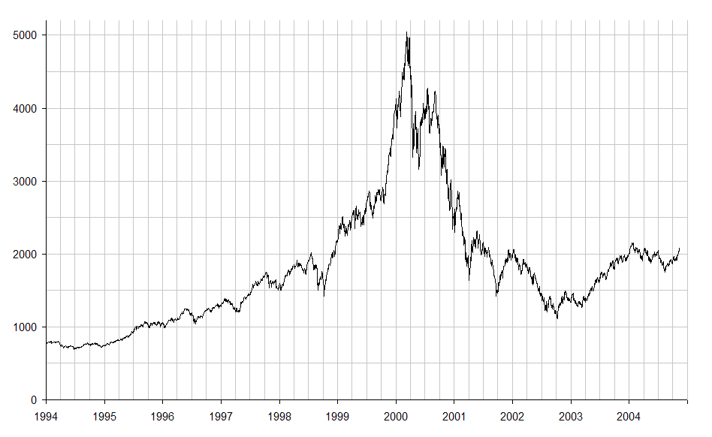
Digression: Silicon Valley Circa 1999
(photo credit: public domain, source https://commons.wikimedia.org)
Notes:
Why do scientists use fruit flies for experiments? Short lifespan == many generations in a short time == fast feedback cycles.

Slide 6
Digression: STMR 3, Fall 2000
?
testers
devs
Notes:
Why do scientists use fruit flies for experiments? Short lifespan == many generations in a short time == fast feedback cycles.

Slide 7
Digression: Better Testing, Worse Quality (2001)
Perceived Quality
Known Bugs
Bug Prevention
QA Team Test Effort
Unknown Bugs
Developer Testing
Bugs Lurking
Choice
Negative correlation
Bugs found in QA

Slide 8
What’s Feedback?
Feedback: the information you get by observing the response to an action.

Slide 9
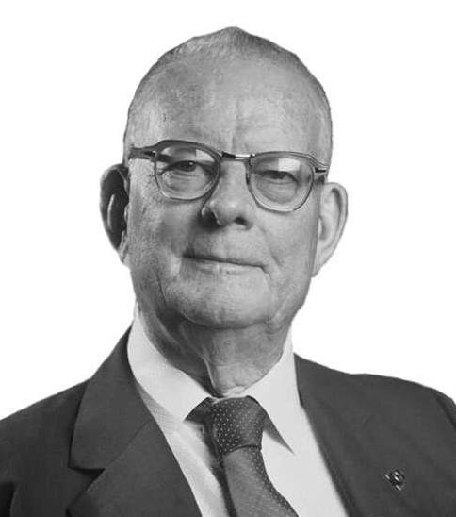
Examples of Feedback Loops: PDCA
(photo credit: census.gov notable alumni)

Slide 10

Examples of Feedback Loops: OODA
(photo credit: public domain from https://commons.wikimedia.org/wiki/File:JohnBoyd_Pilot.jpg)

Slide 11
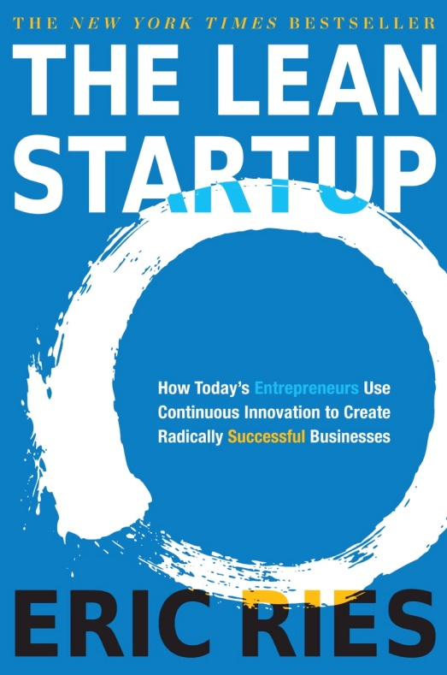
Examples of Feedback Loops: Lean Startup

Slide 12
Types of Feedback
Dev tests: As a programmer, did I write the code I intended to write?
CI: …without violating any existing expectations in the code?
Exploratory testing: Did we introduce any unintended consequences?
Acceptance testing: Did I get the feature I asked for?
Stakeholder feedback: As a team, are we headed in the right direction?
User feedback: Are we producing something our customers/users love?

Slide 13
Feedback Cycle Time Varies
Automated Unit Tests
Automated System Tests
CI build w/ tests
Exploring
Manual scripted regression testing
Statistical analysis of production metrics
Customer Opinion

Slide 14
Why Doesn’t a Traditional Cycle Work?
Because empirical evidence trumps speculation and opinion every time.
RISK
Speculation
Big Bang Release
Analyze
Design
Implement
Stabilize

Slide 15



Digression: Schrödinger’s Cat

Slide 16
Agile (theoretically) Eliminates Speculation Buildup
Speculation
Iteration
Iteration
Iteration
Iteration
Iteration

Slide 17
…except when it’s frAgile
RISK
Speculation
Test
Iterations…

Slide 18
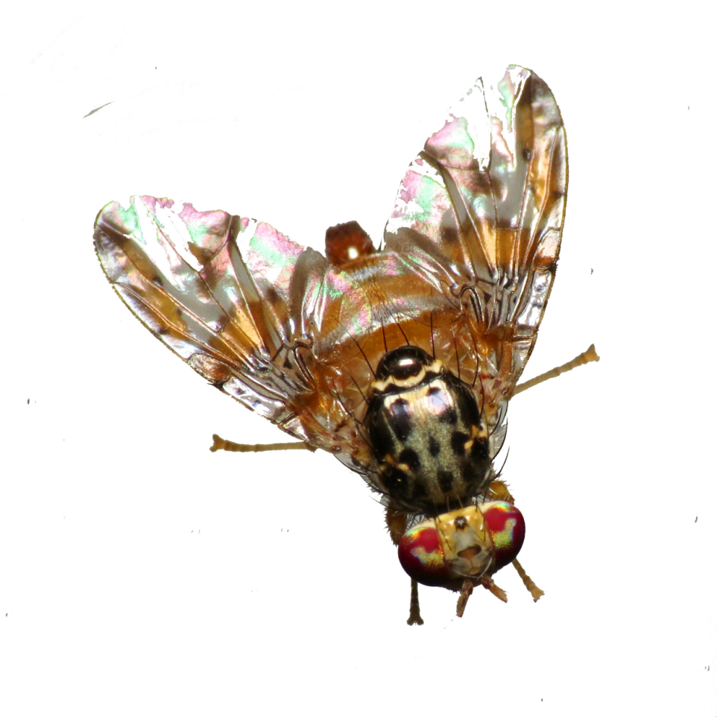
Digression: Fruit Flies
(photo credit: Katja Schulz https://flic.kr/p/e1Ytgq)
Notes:
Why do scientists use fruit flies for experiments? Short lifespan == many generations in a short time == fast feedback cycles.

Slide 19
Tightening Feedback Cycles (Example 1)
BEFORE: days - weeks
Unit Test
Test in Local Env
Check in on Branch
Merge
Unit Test
System Test
Code Review
AFTER: mins - hours
Pair
Run local tests
Check into Master
CI Runs All Tests

Slide 20
Tightening Feedback Cycles (Example 2)
Long-lived team branches
Short-lived feature branches

Slide 21
Polluted Feedback Streams
False alarms / false failures
Distortions
Lost information

Slide 22
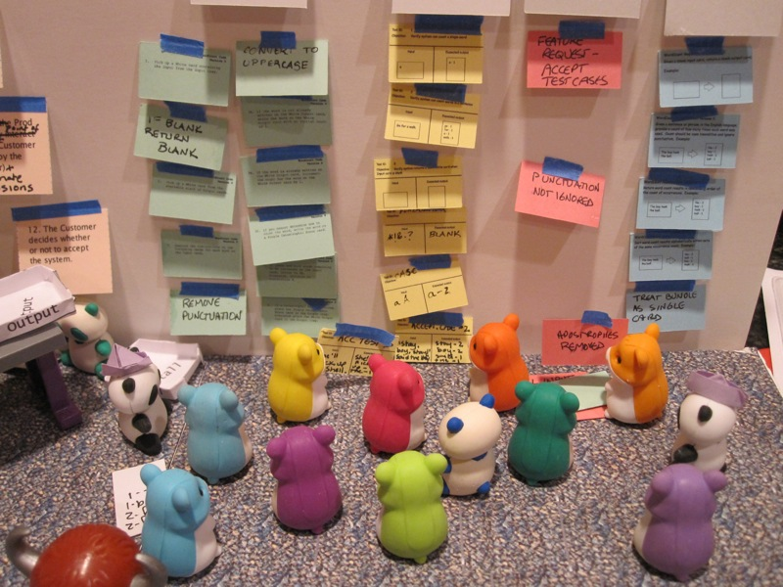
Digression: WordCount Simulation

Slide 23
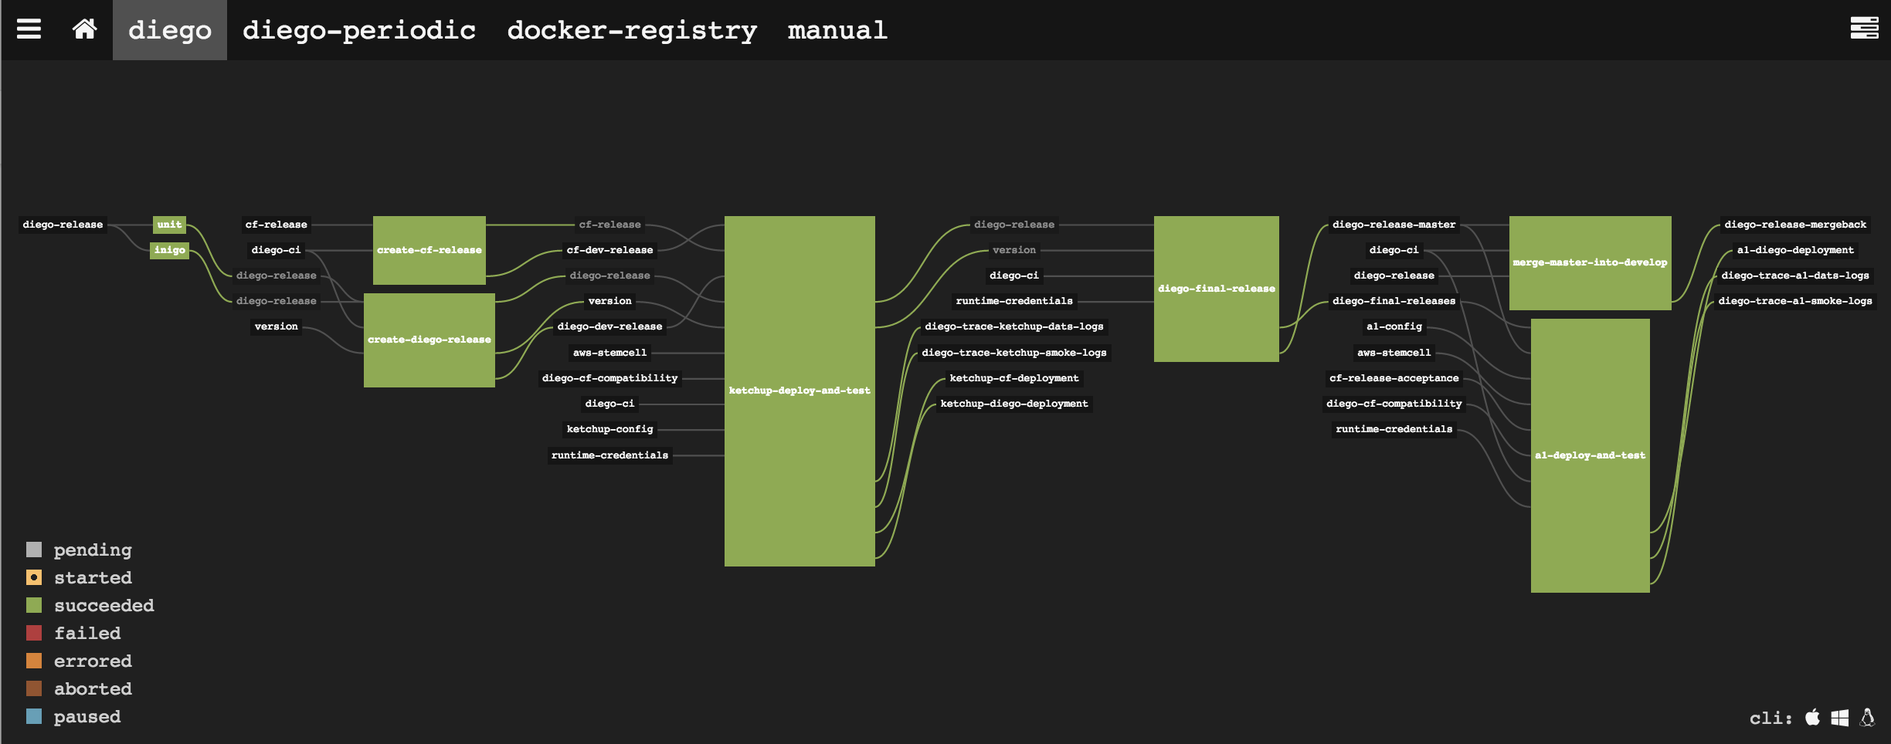
Visibility

Slide 24
Feedback Entropy
Without intentional effort:
Test suites and build times grow unbounded
Feedback becomes polluted
People seek the illusion of speed over actual progress

Slide 25
Transformation Lessons Learned
Fighting feedback entropy takes enormous energy.
Meetings are easy; getting real work done is hard.
Tools and test frameworks are foundational: the devs who build them have to be better than average.
Visibility is more important than I ever imagined.
Figuring out where to draw the lines in a system is HARD.
Branching hurts even more than I thought.

Slide 26


Caring for Your Feedback Cycles?

Slide 27
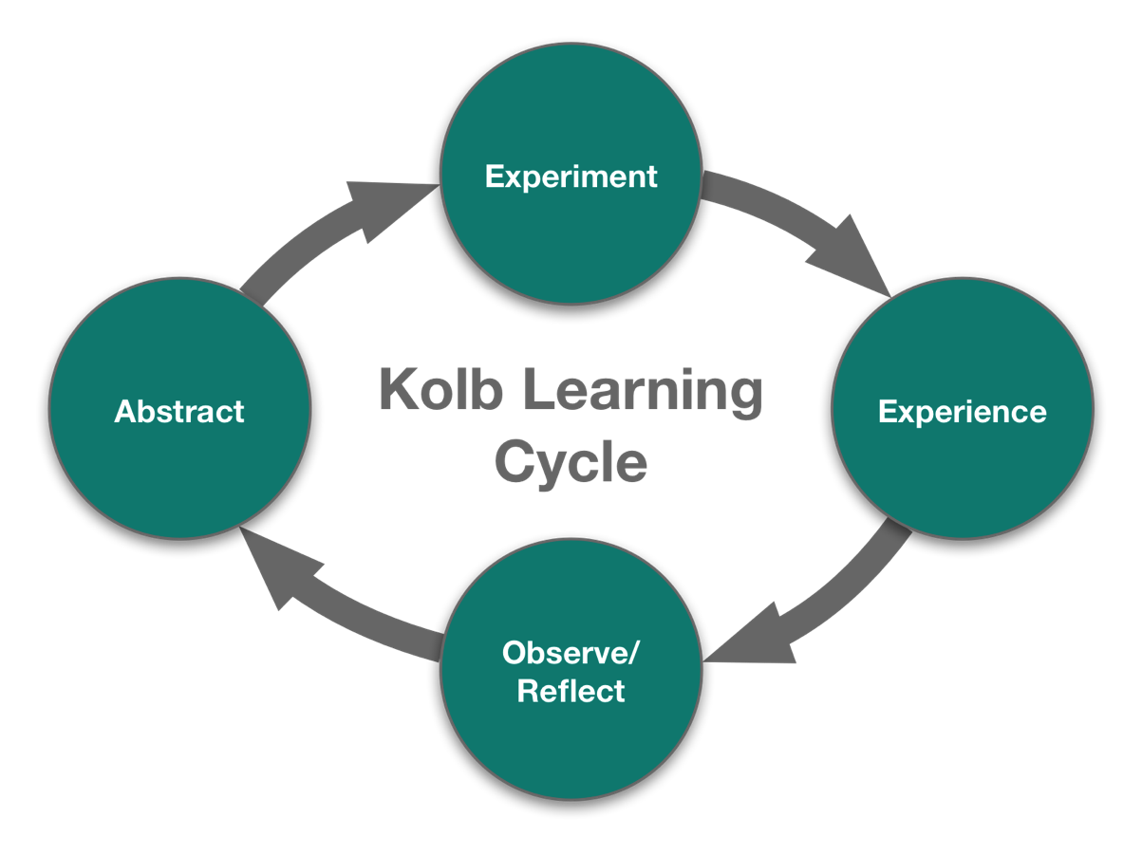
Feedback Cycles are Learning Cycles

Slide 28
There is no failure. There is only learning.
(and some weeks I do a LOT of learning.)

Slide 29
Credit
Ratio of Programmers to Testers
At STMR3 in San Jose, CA, Fall 2000 we discussed the ratio of programmers to testers. Participants included Sue Bartlett, Laura Anneker, Fran McKain, Elisabeth Hendrickson, Bret Pettichord, Chris DeNardis, George Hamblen, Jim Williams, Brian Lawrence, Cem Kaner, Jennifer Smith-Brock, Kathy Iberle, Hung Quoc Nguyen, and Neal Reizer

Slide 30
References
…or “How do I find those totally obscure papers you mentioned?”
Wordcount Simulation http://agilistry.com/downloads/WordCountLessons.pdf
Kaner, Hendrickson, Smith-Brock. “Managing the Proportion of Testers to (Other) Developers.” http://kaner.com/pdfs/pnsqc_ratio_of_testers.pdf
Hendrickson. ”Better Testing, Worse Quality.” http://testobsessed.com/wp-content/uploads/2011/04/btwq.pdf

